Slide 1
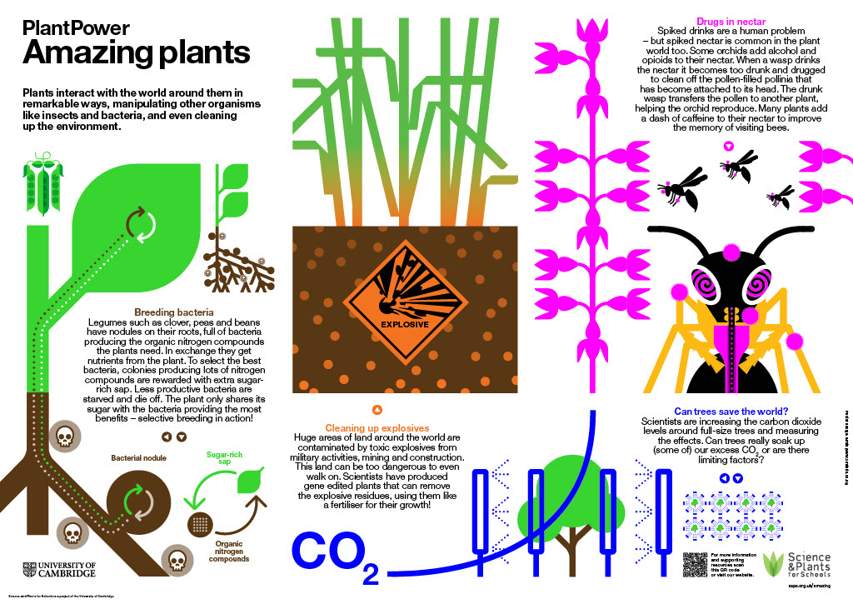
PlantPower
Amazing plants
Notes:
Amazing Plants Poster
www.saps.org.uk
Resource 4845, version 1.1 (Released 2023)

Slide 2
Notes:
SAPS Amazing Plants Poster

Slide 3
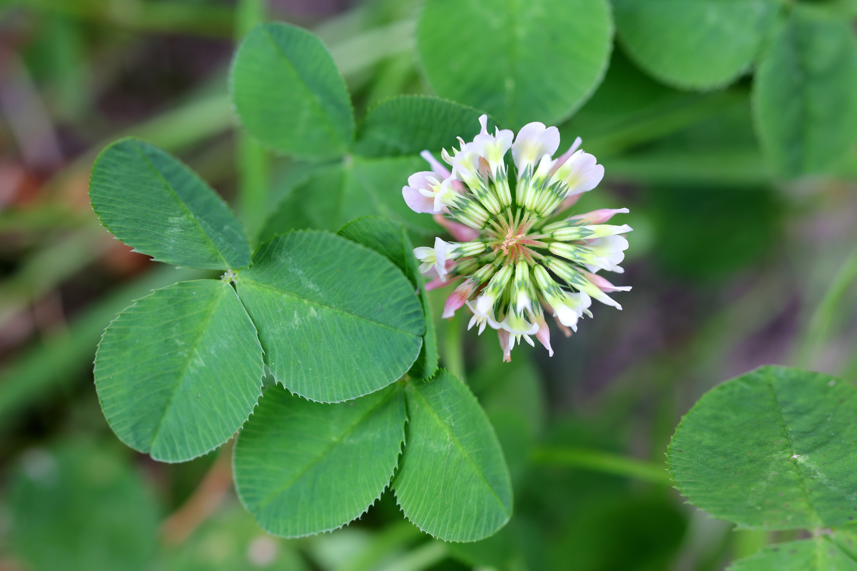
Breeding bacteria
Notes:
Photo of white clover credit Anthony Short.
Clover is common in grass including playing fields, parks and gardens. It is an example of a legume – plants that have special nodules on their roots containing bacteria that convert nitrogen from the air into nitrates that can be used by the plants to build proteins in return for sugars made by the plant during photosynthesis. The first three slides are of legumes students may have seen – clover – and may be less familiar with (alfalfa or lucerne, often grown as a feed crop for animals and the enrich soil).

Slide 4
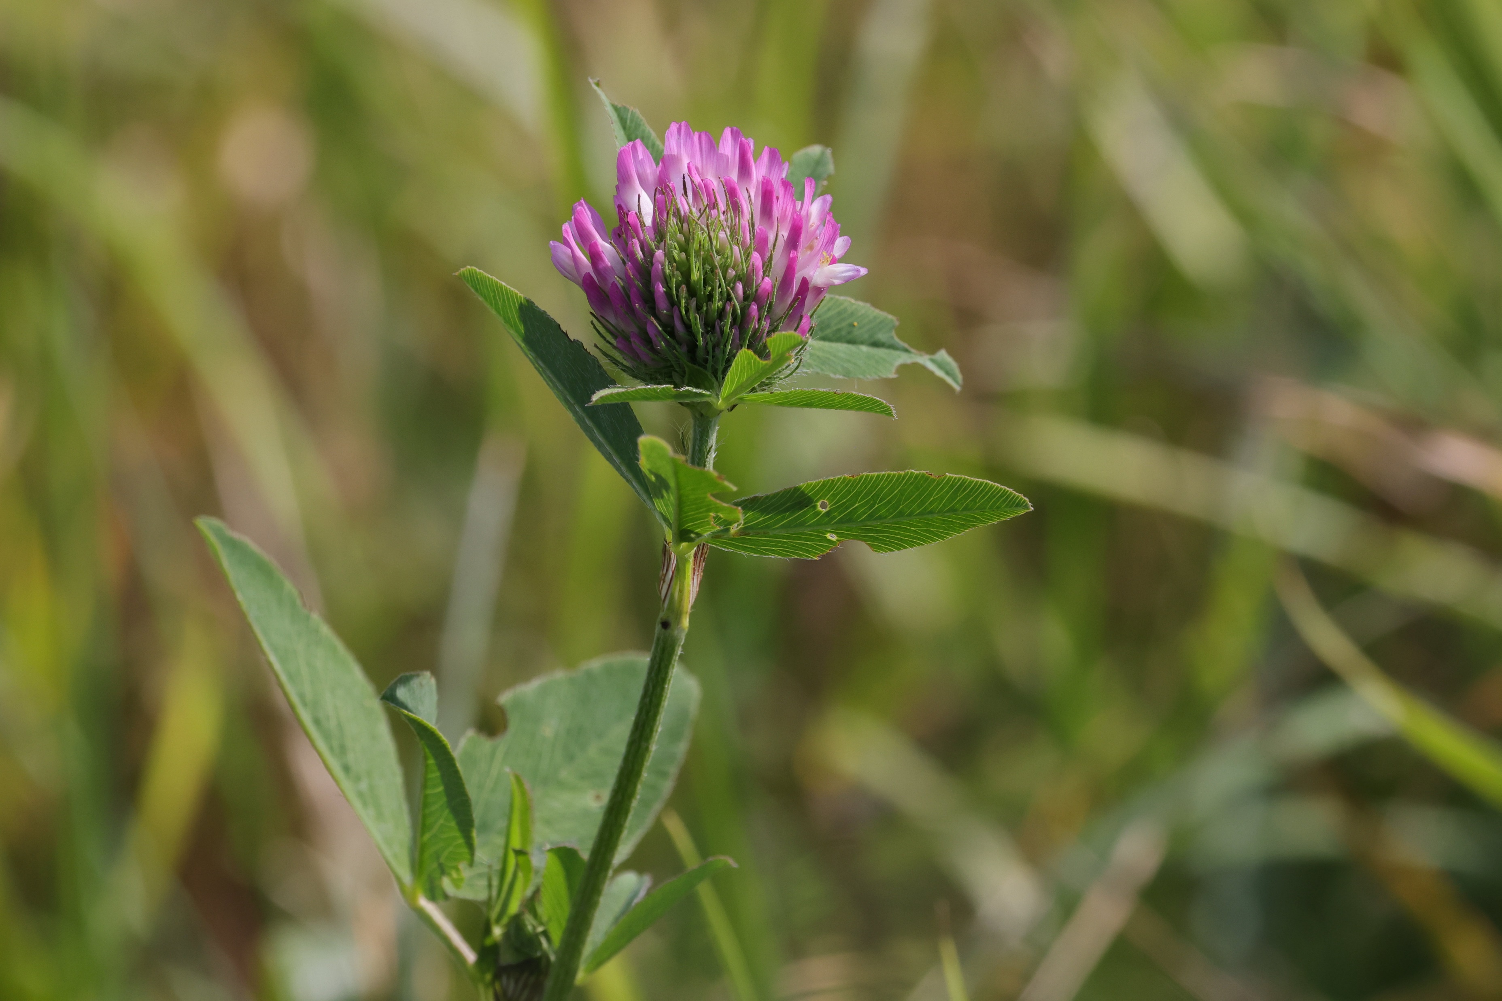
Breeding bacteria
Notes:
Red clover credit Anthony Short.
Suggested prompts/questions: White clover and red clover grow commonly as wild flowers – but they are also grown as crops to enrich the soil and feed animals. What other legumes have you come across? Legumes will sometimes grow on soil that does not support many other crops – suggest how they do this?

Slide 5
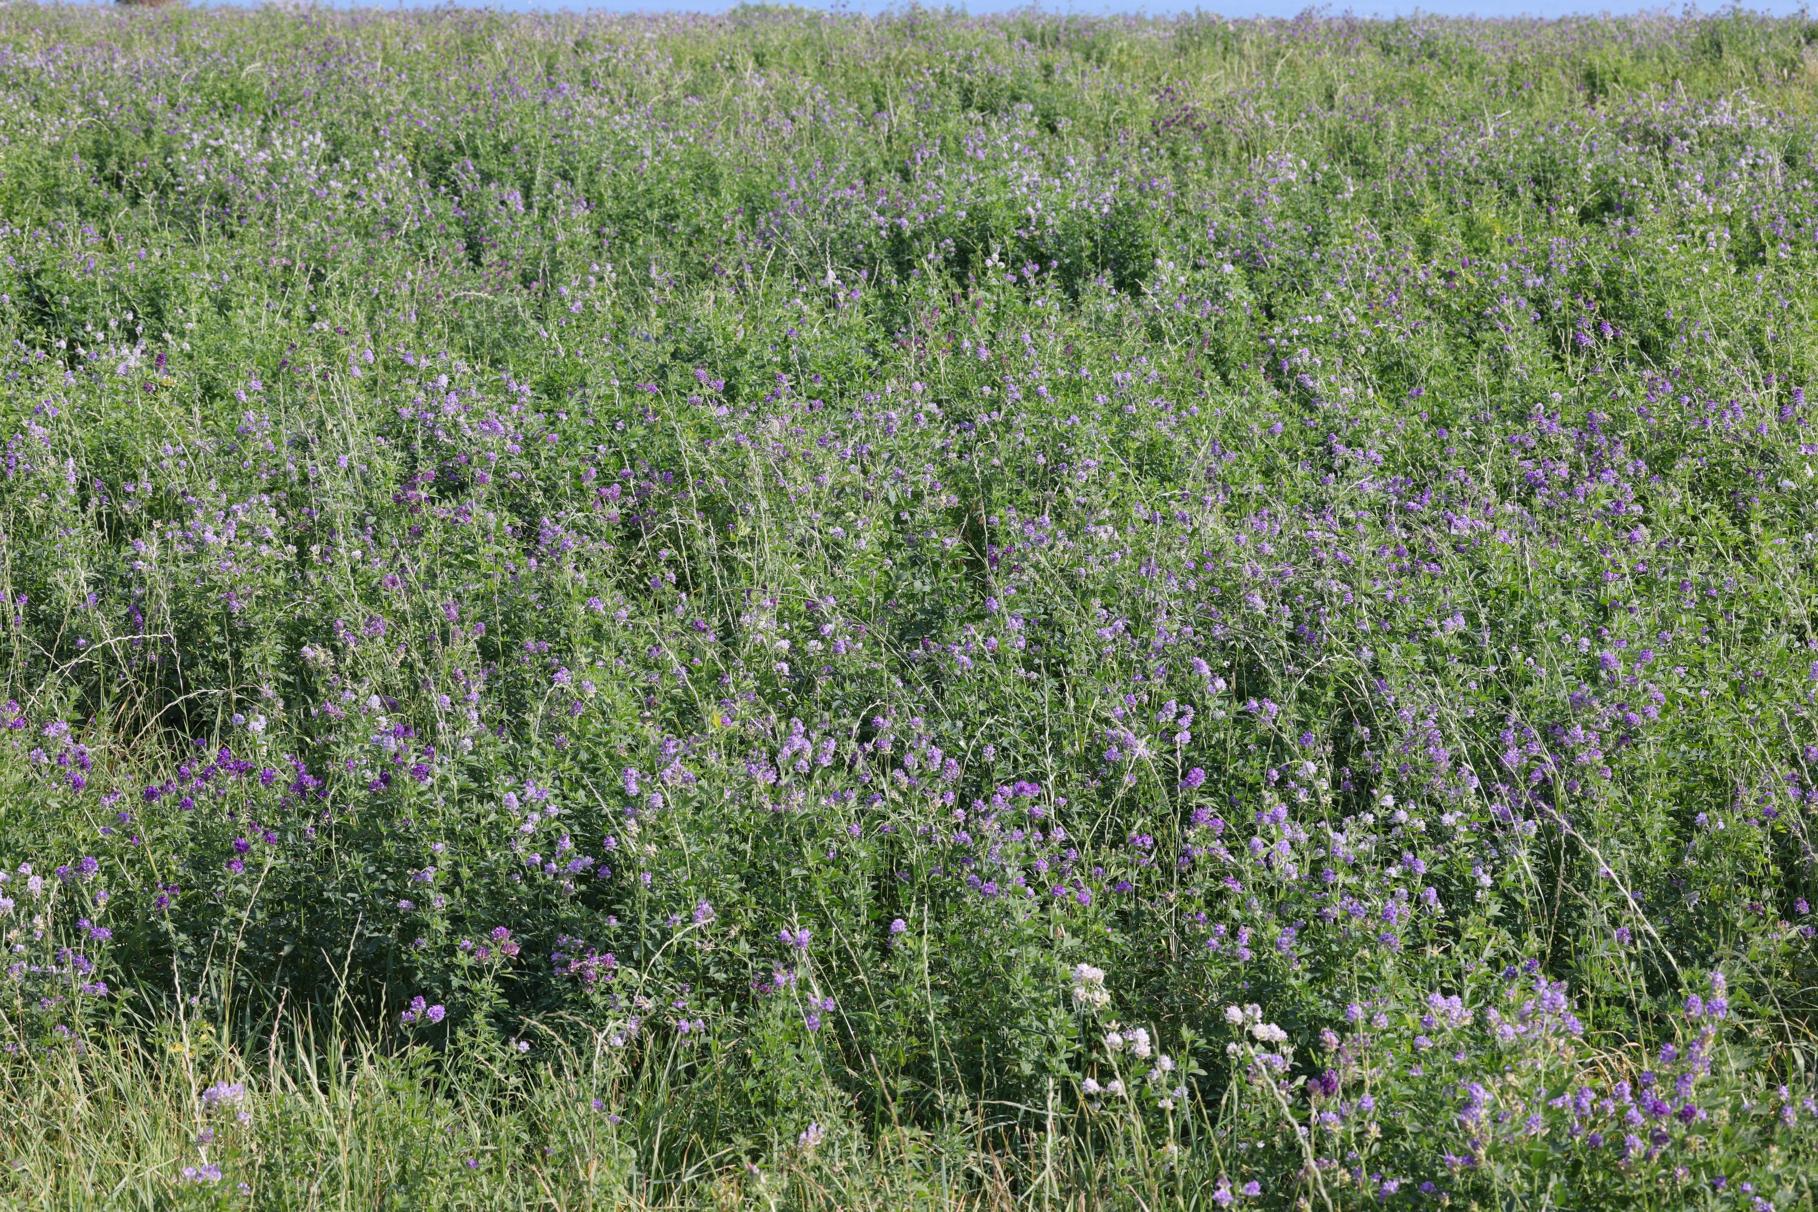
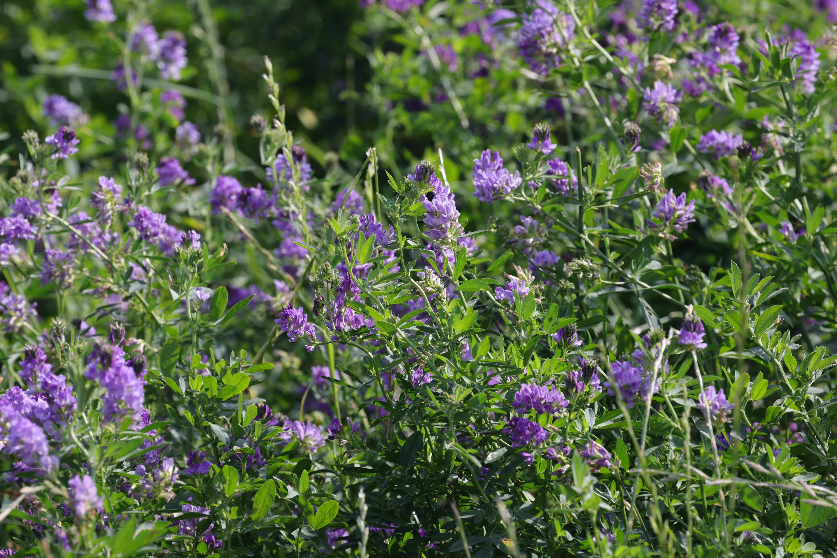
Breeding bacteria
Notes:
Alfalfa crop and detail of plants Credit Anthony Short.
Lucerne – also known as alfalfa - is grown as food for cattle. It is also grown to make soil fertile again after it has been used to grow mineral-hungry crops. Suggest why legumes are used to restore soil fertility.

Slide 6
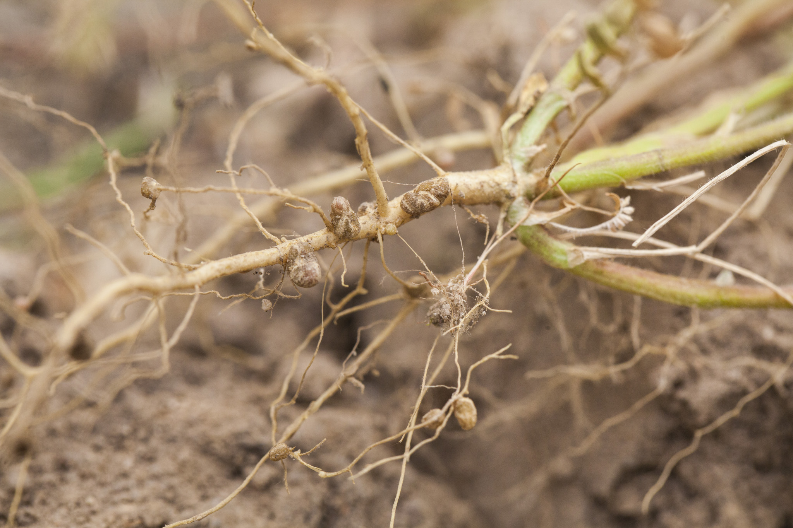
Breeding bacteria
Notes:
https://commons.wikimedia.org/wiki/File:Nitrogen-fixing_nodules_in_the_roots_of_legumes..JPG
The bacteria that fix nitrogen from the air are found in root nodules on legumes. Think about selective breeding – the way people have bred from animals or plants that have the features that they want. Scientists have discovered that legumes carry out the same process on their bacterial cultures – and that they are ruthless in the way they do it. Ask students why plants need nitrates/why legumes might make their own nitrates/ ways in which a plant might select the best nitrifying bacteria. The truth is brutal – they simply starve poorly performing bacteria to death!

Slide 7
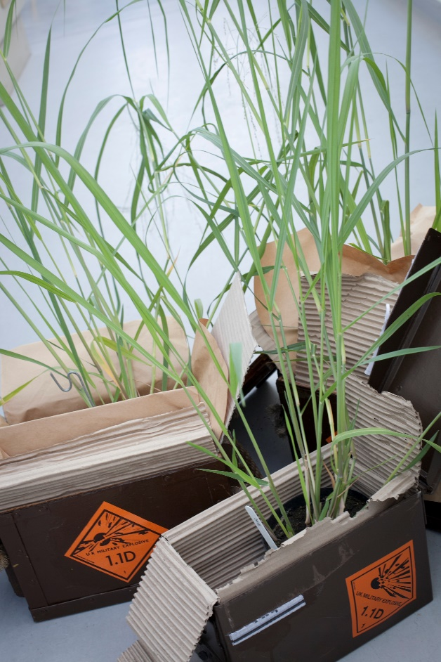
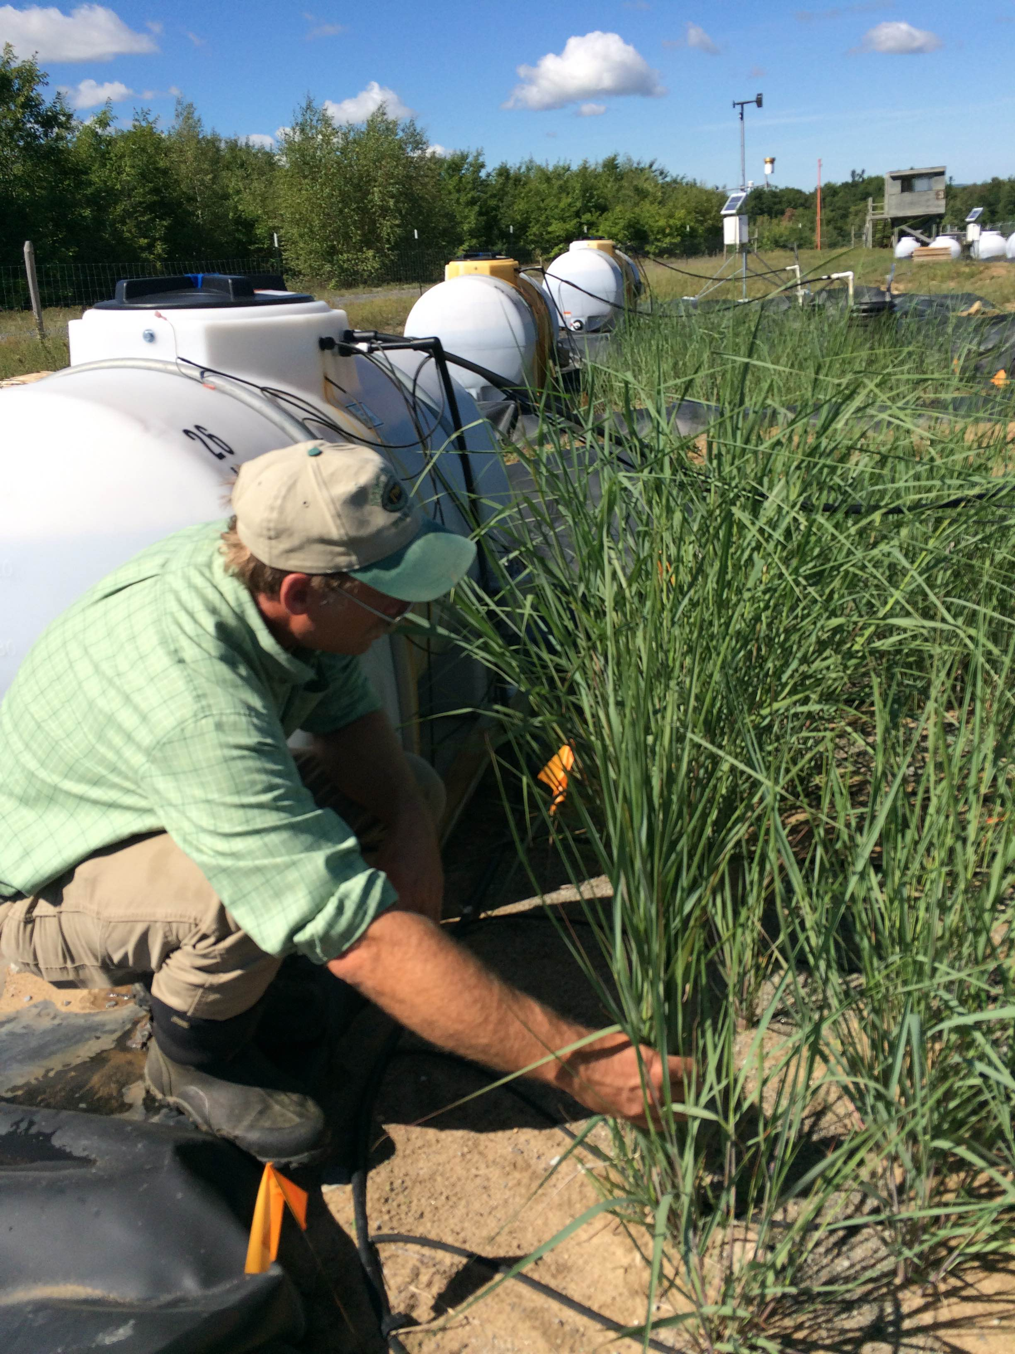
Cleaning up explosives
Notes:
Plants that absorb explosives Credit Phil Roberts BBSRC and Dr Liz Rylott.
In the US alone or 1.2 million tonnes of soil are contaminated with toxic and dangerous explosive residues – and this is replicated and even exceeded in countries around the world. Ask students where they think these residues might come from. Introduce concept of bioremediation – using plants to clean up the soil – and the idea of gene editing plants to make this more efficient e.g. research at the University of York

Slide 8
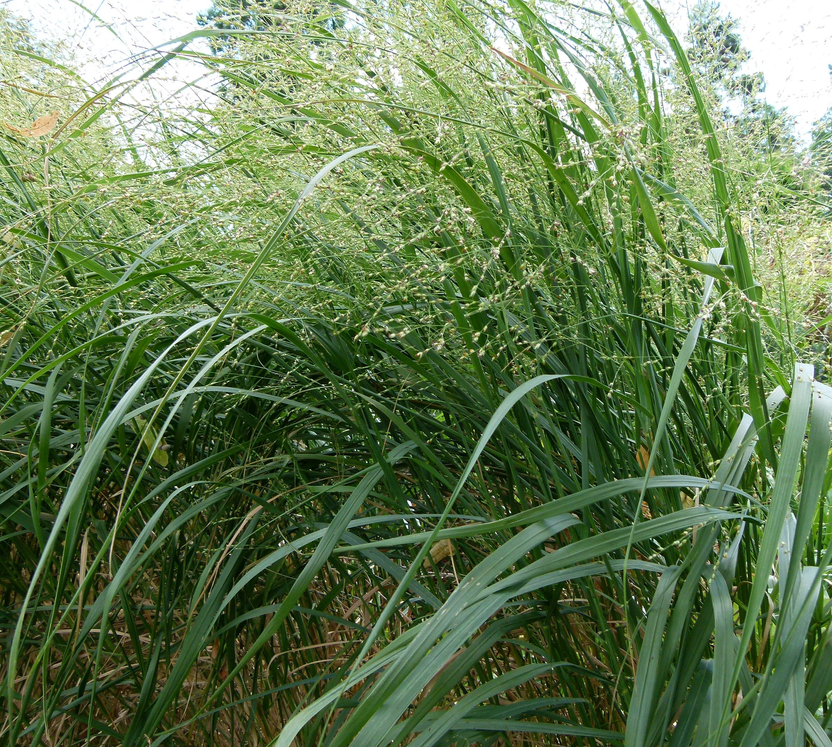
Cleaning up explosives
Notes:
https://commons.wikimedia.org/wiki/File:Panicum_virgatum_Parc_floral.JPG
Switch grass is tough and grows in many places. Using gene editing, scientists have developed a form of switch grass which absorbs explosive residues from the soil, making the soil safe again. Even more excitingly, the plants convert some explosive residues into molecules they can use, so they grow fast and strong.

Slide 9
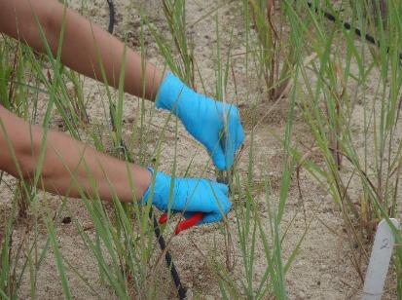
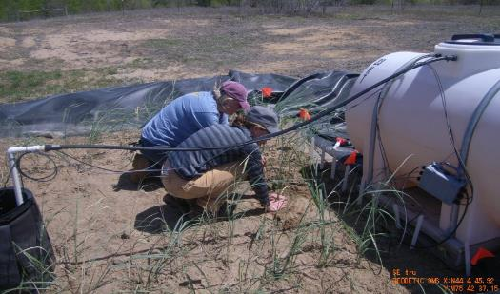
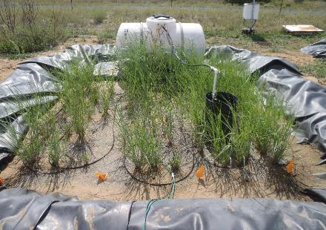
Cleaning up explosives
Planting
Taking samples for analysis
View of plot
Notes:
Photos courtesy of Dr Liz Rylott
Field trial set up for research into phytoremediation at the University of York. The tanks contain water with RDX (an explosive). The tanks supply the plots with RDX/water, but also take excess rainwater off the plots. It is a 'closed system' in that the plots are lined, so the researchers can account for the fate of all the RDX at the end of the experiment.

Slide 10
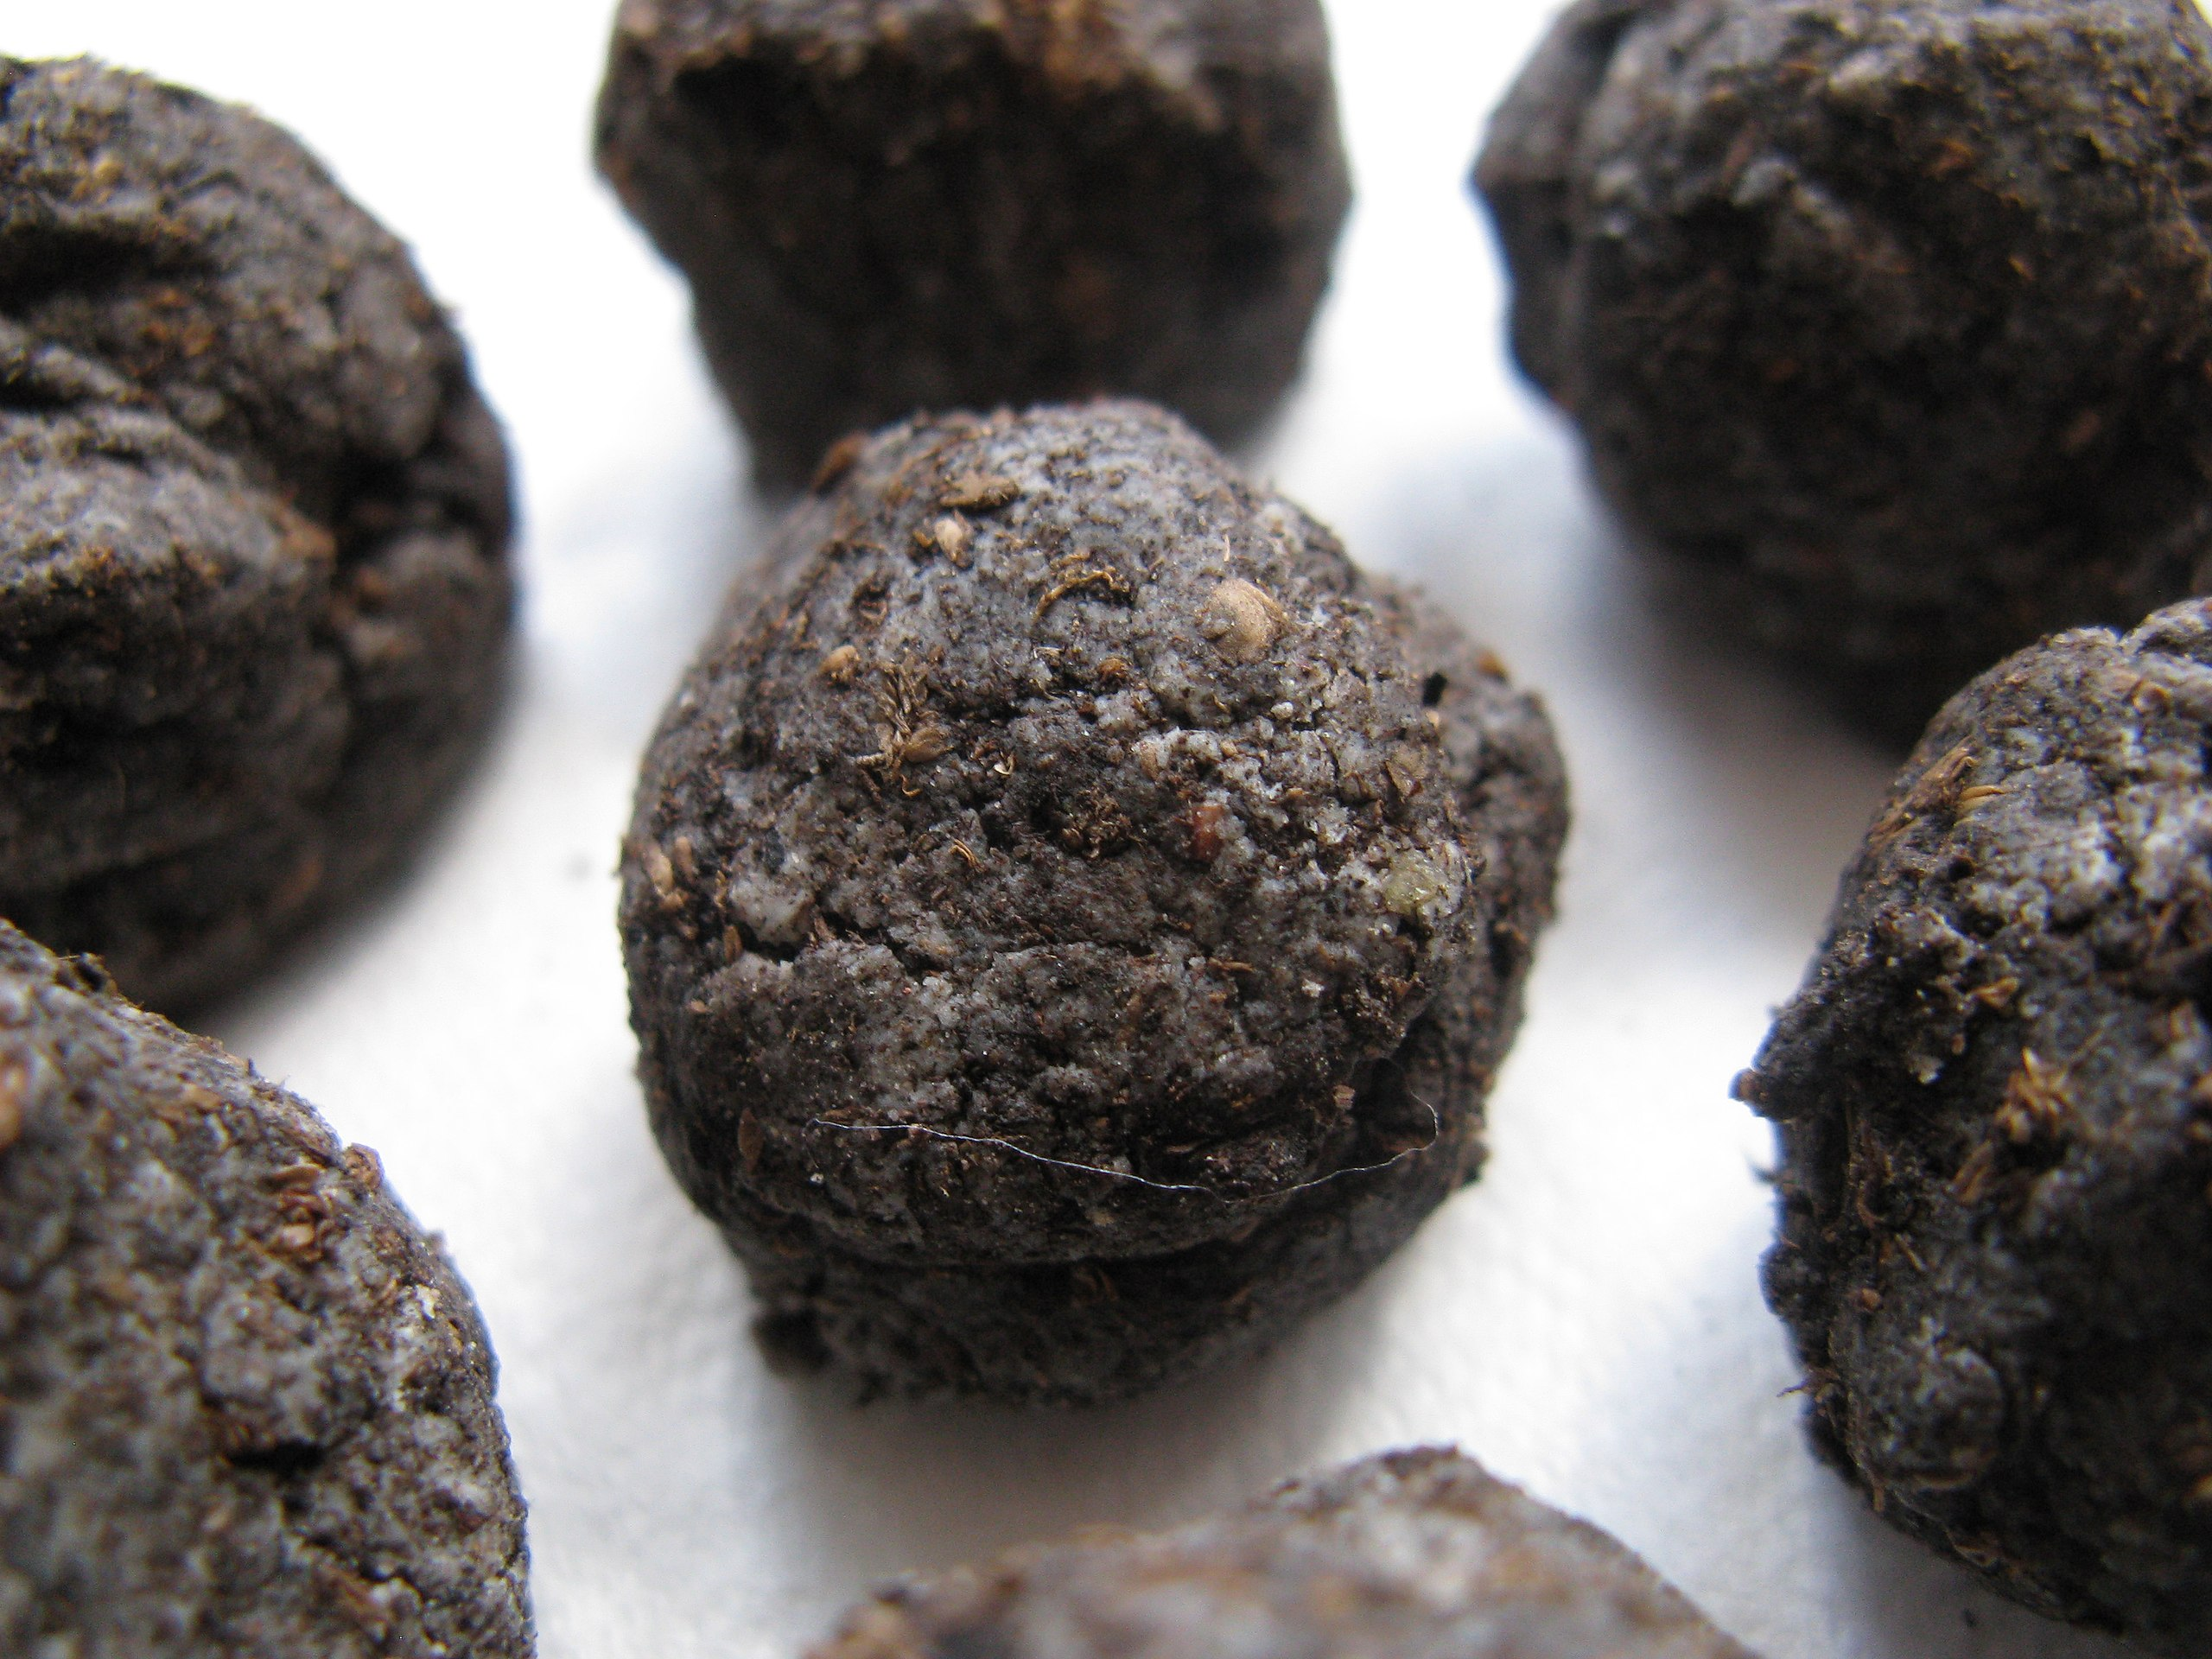
Cleaning up explosives
Notes:
https://commons.wikimedia.org/wiki/File:Seed_Bombs.jpg
Soil contaminated by explosives can be just that – explosive! As well as developing gene edited plants to break down the explosive residues, scientists had to develop seed bombs for dropping from helicopters and light aircraft, to plant the seeds safely. Ask students to suggest why this was necessary. What criteria might be used to measure the success of the project?

Slide 11
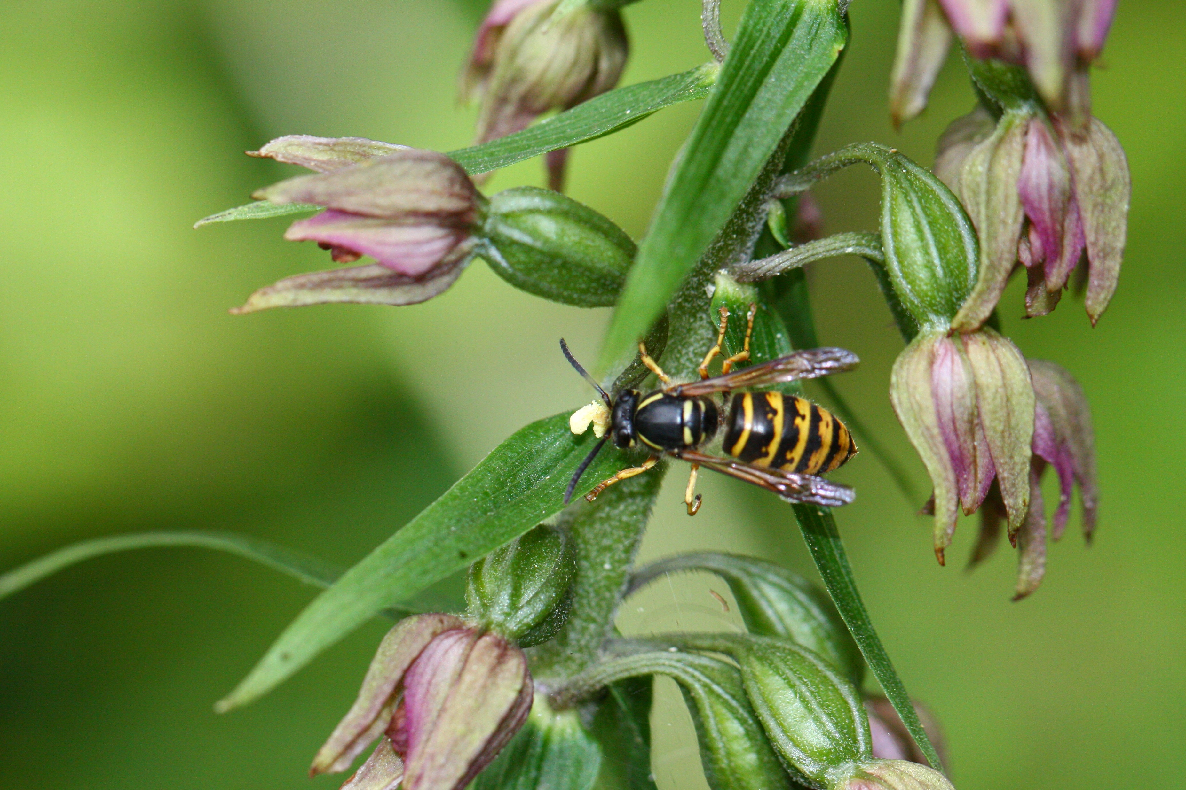
Drugs in nectar
Notes:
Broad leaved helleborine with wasp Credit Anthony Short.
Broad leaved helleborine orchids are a widespread species across Europe and Asia The flowers are not very brightly coloured or conspicuous but they have evolved a number of adaptations which make them irresistible to the wasps they rely on to pollinate them. Trick 1: the flowers release the scent made by plants such as cabbages when they are attacked by caterpillars. The wasps normally lay their eggs in these caterpillars, so they are attracted to the orchids by this deceptive scent.

Slide 12
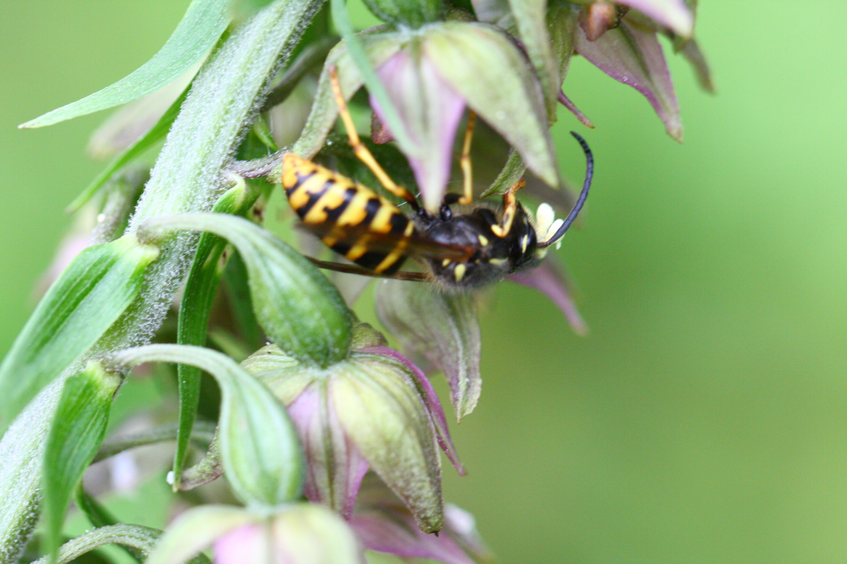
Drugs in nectar
Notes:
Broadleaved helleborine with pollinating wasp. Credit Anthony Short.
Trick 2: The broadleaved helleborine produces sugary nectar that ferments to form an alcoholic brew – spiked with opioids also made by the plant. Wasps, lured by the possibility of caterpillars to parasitise, are distracted by the sweet nectar and drink it. They rapidly become ‘drunk’, sluggish and uncoordinated. They stay on the flowers longer, increasing the chances of getting sticky, pollen filled pollinia stuck to their heads. And when they do, they lack the coordination to clean the pollinia off – instead flying off to another highly attractive helleborine flower which they pollinate as they seek more delicious nectar. This only works for a couple of wasp species – other insects are repelled by the spiked nectar. Ask students to consider the pros and cons of a very specific strategy like this for the plant.

Slide 13
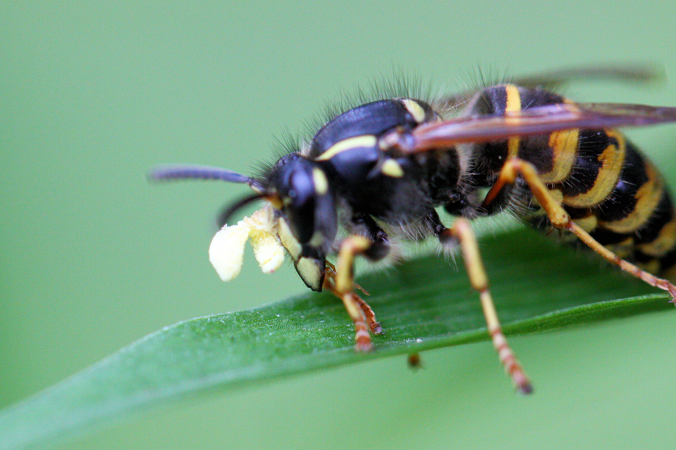
Drugs in nectar
Notes:
Wasp with broad-leafed helleborine pollinia stuck to its head. Credit Anthony Short.
This wasp has pollinia stuck to its head – look carefully and you can see the individual pollen grains. Wasps are normally very clean – they remove anything that gets stuck to their body. Ask students to consider the interdependencies in this relationship, the examples of communication and the different adaptations in the two species involved.

Slide 14
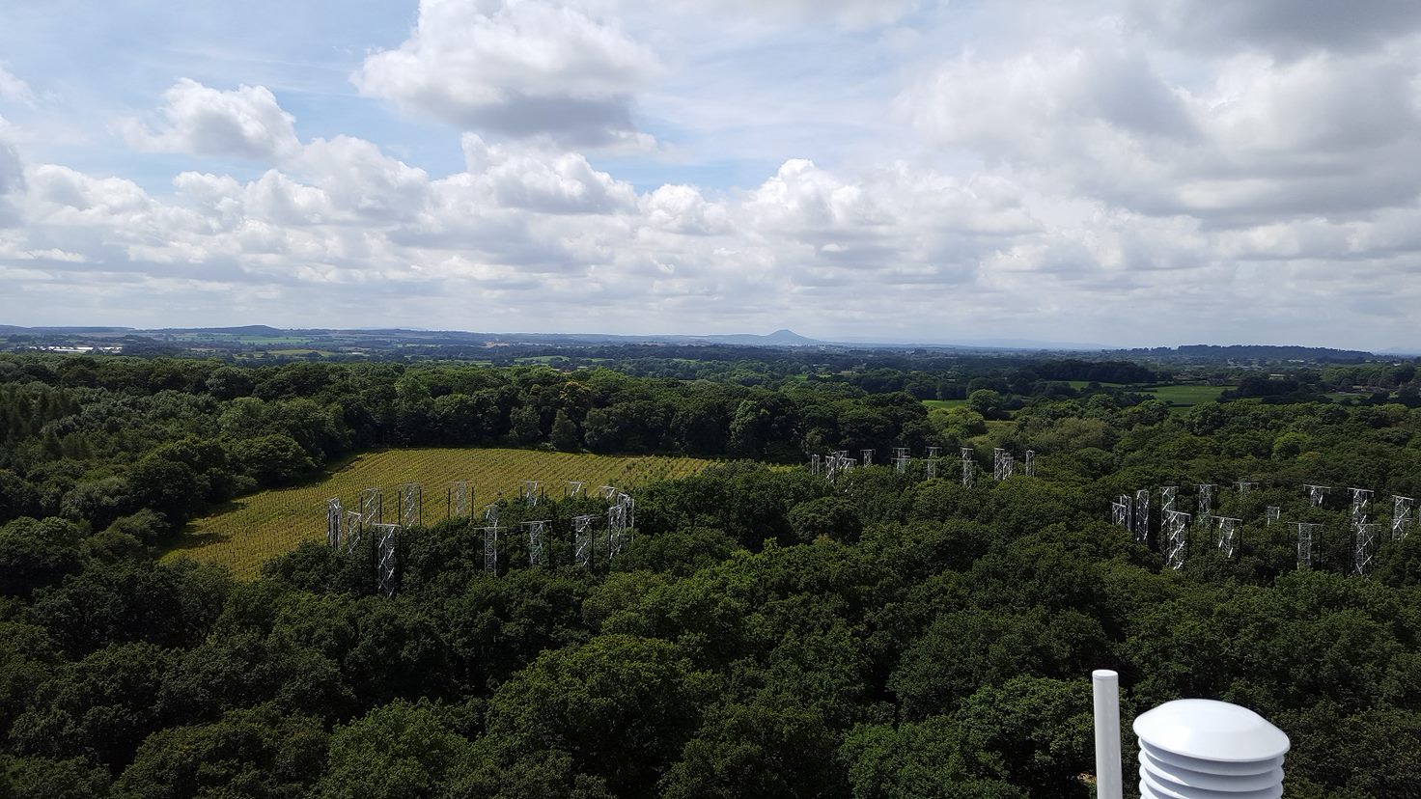
Can trees save the world?
Notes:
Birmingham Institute of Forest Research (BIFoR).
Quiz students on their knowledge of photosynthesis, and the importance of carbon dioxide in making carbohydrates. Discuss the known role of trees as carbon sinks and the rising levels of carbon dioxide in the atmosphere. Ask for ideas on the possible impacts of rising carbon dioxide levels on trees – then describe the studies being done at the Birmingham Institute of Forest Research. Here they have set up enormous arrays in mature woodland where they are investigating the effects of different levels of carbon dioxide in the atmosphere around the trees in real time at different times of year. Here the arrays are shown in summer when the trees are in full leaf.

Slide 15
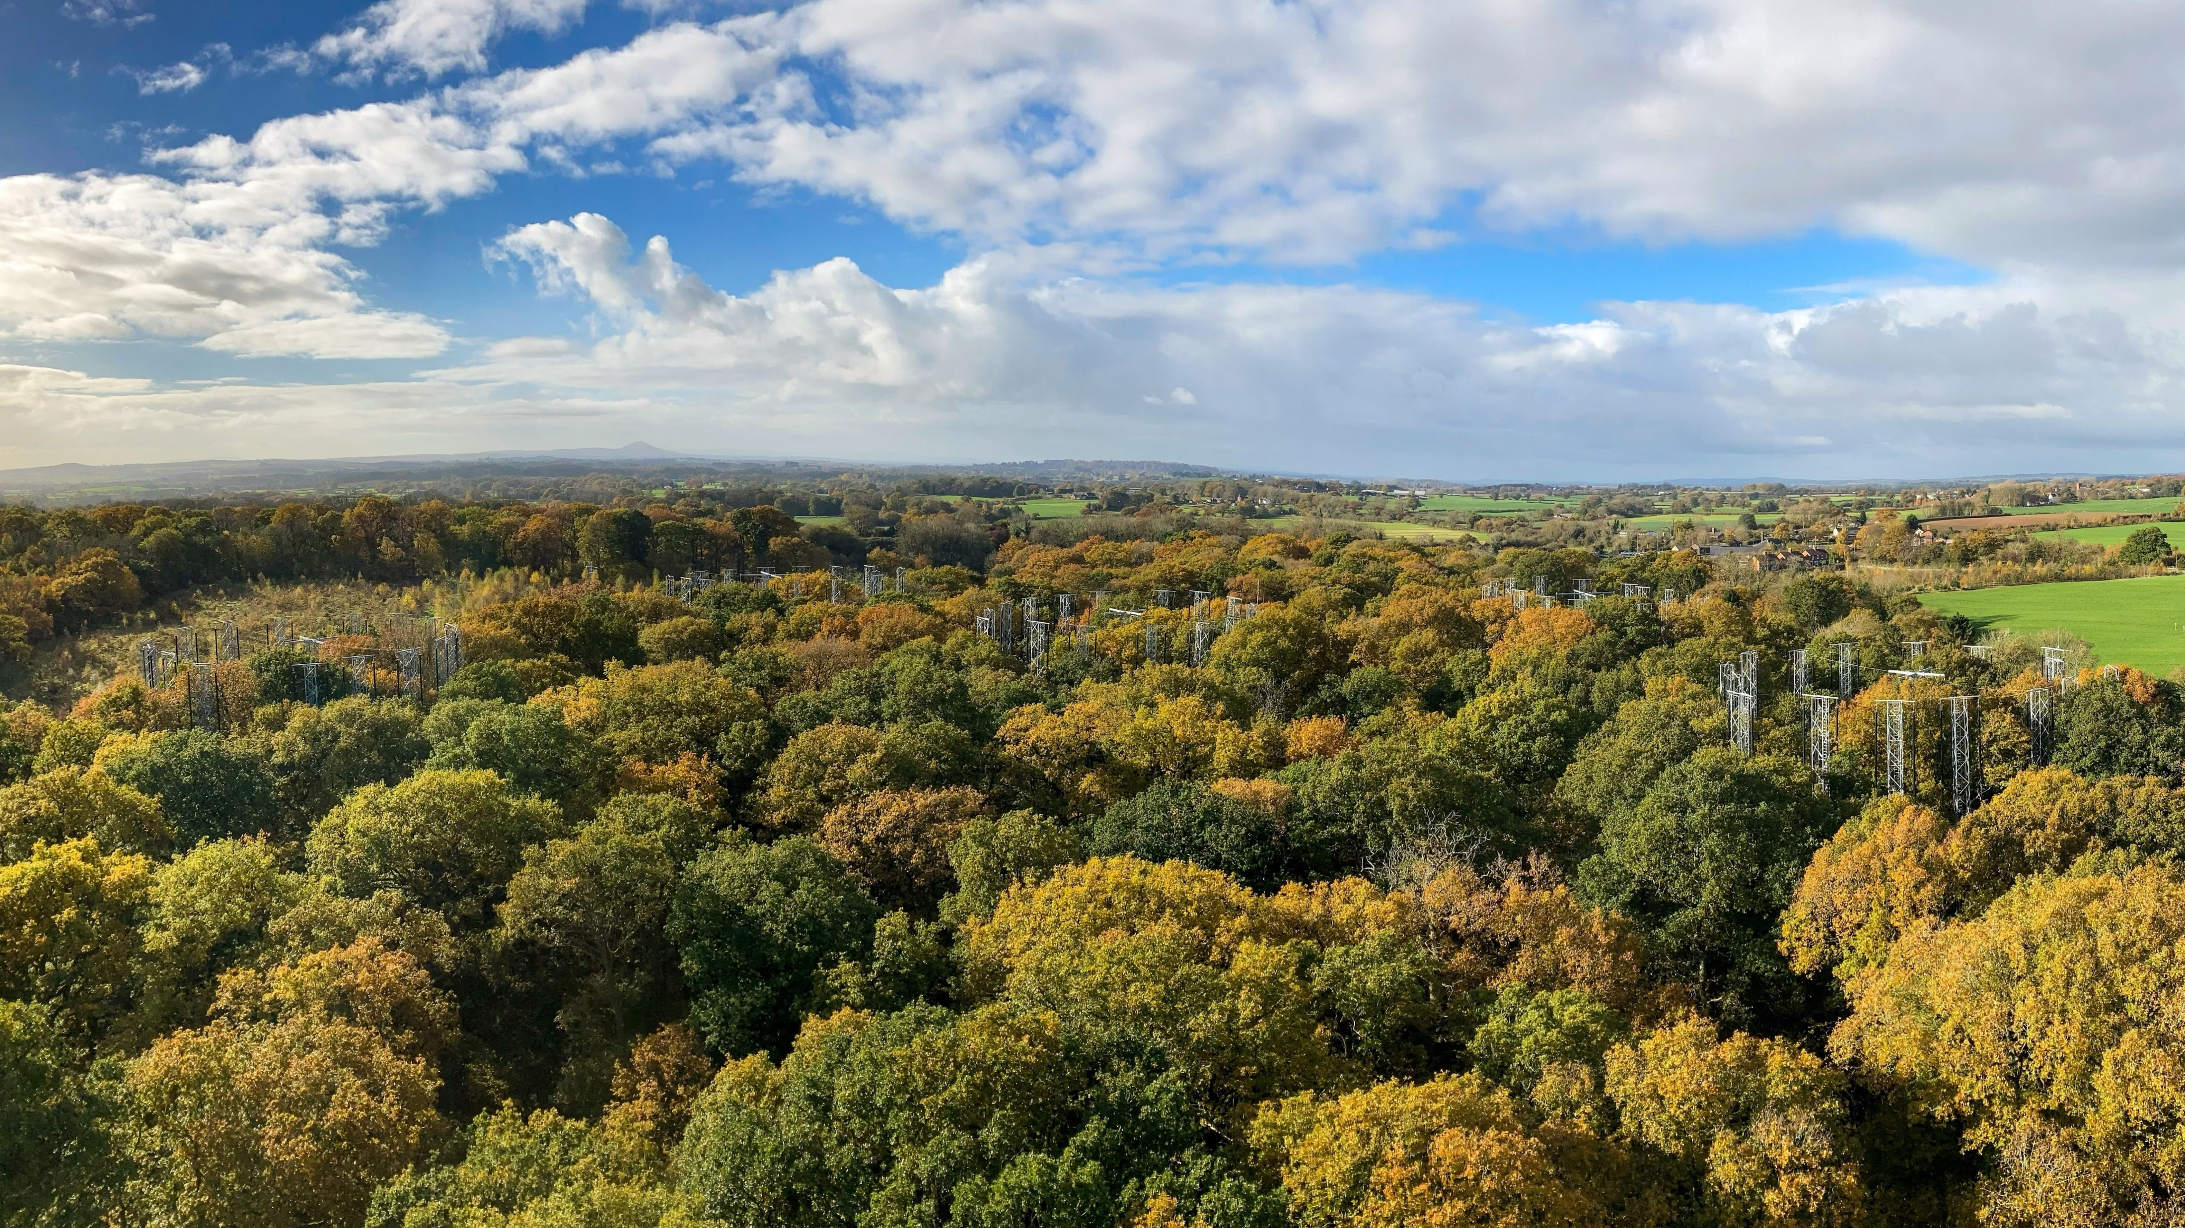
Can trees save the world?
Notes:
BIFoR arrays in autumn Credit Thomas Downes (BIFoR) .
The BIFoR arrays in autumn – this images gives a good idea of the scale of the experiment! There are lots of resources on the BIFoR website and students can carry out their own investigations as part of a citizen science project. This makes a useful discussion point for students on the changes in trees in autumn and what happens as the leaves change colour and fall, for example. Students might have ideas on the affect raised carbon dioxide levels might have on the time trees hold on to their leaves etc.

Slide 16
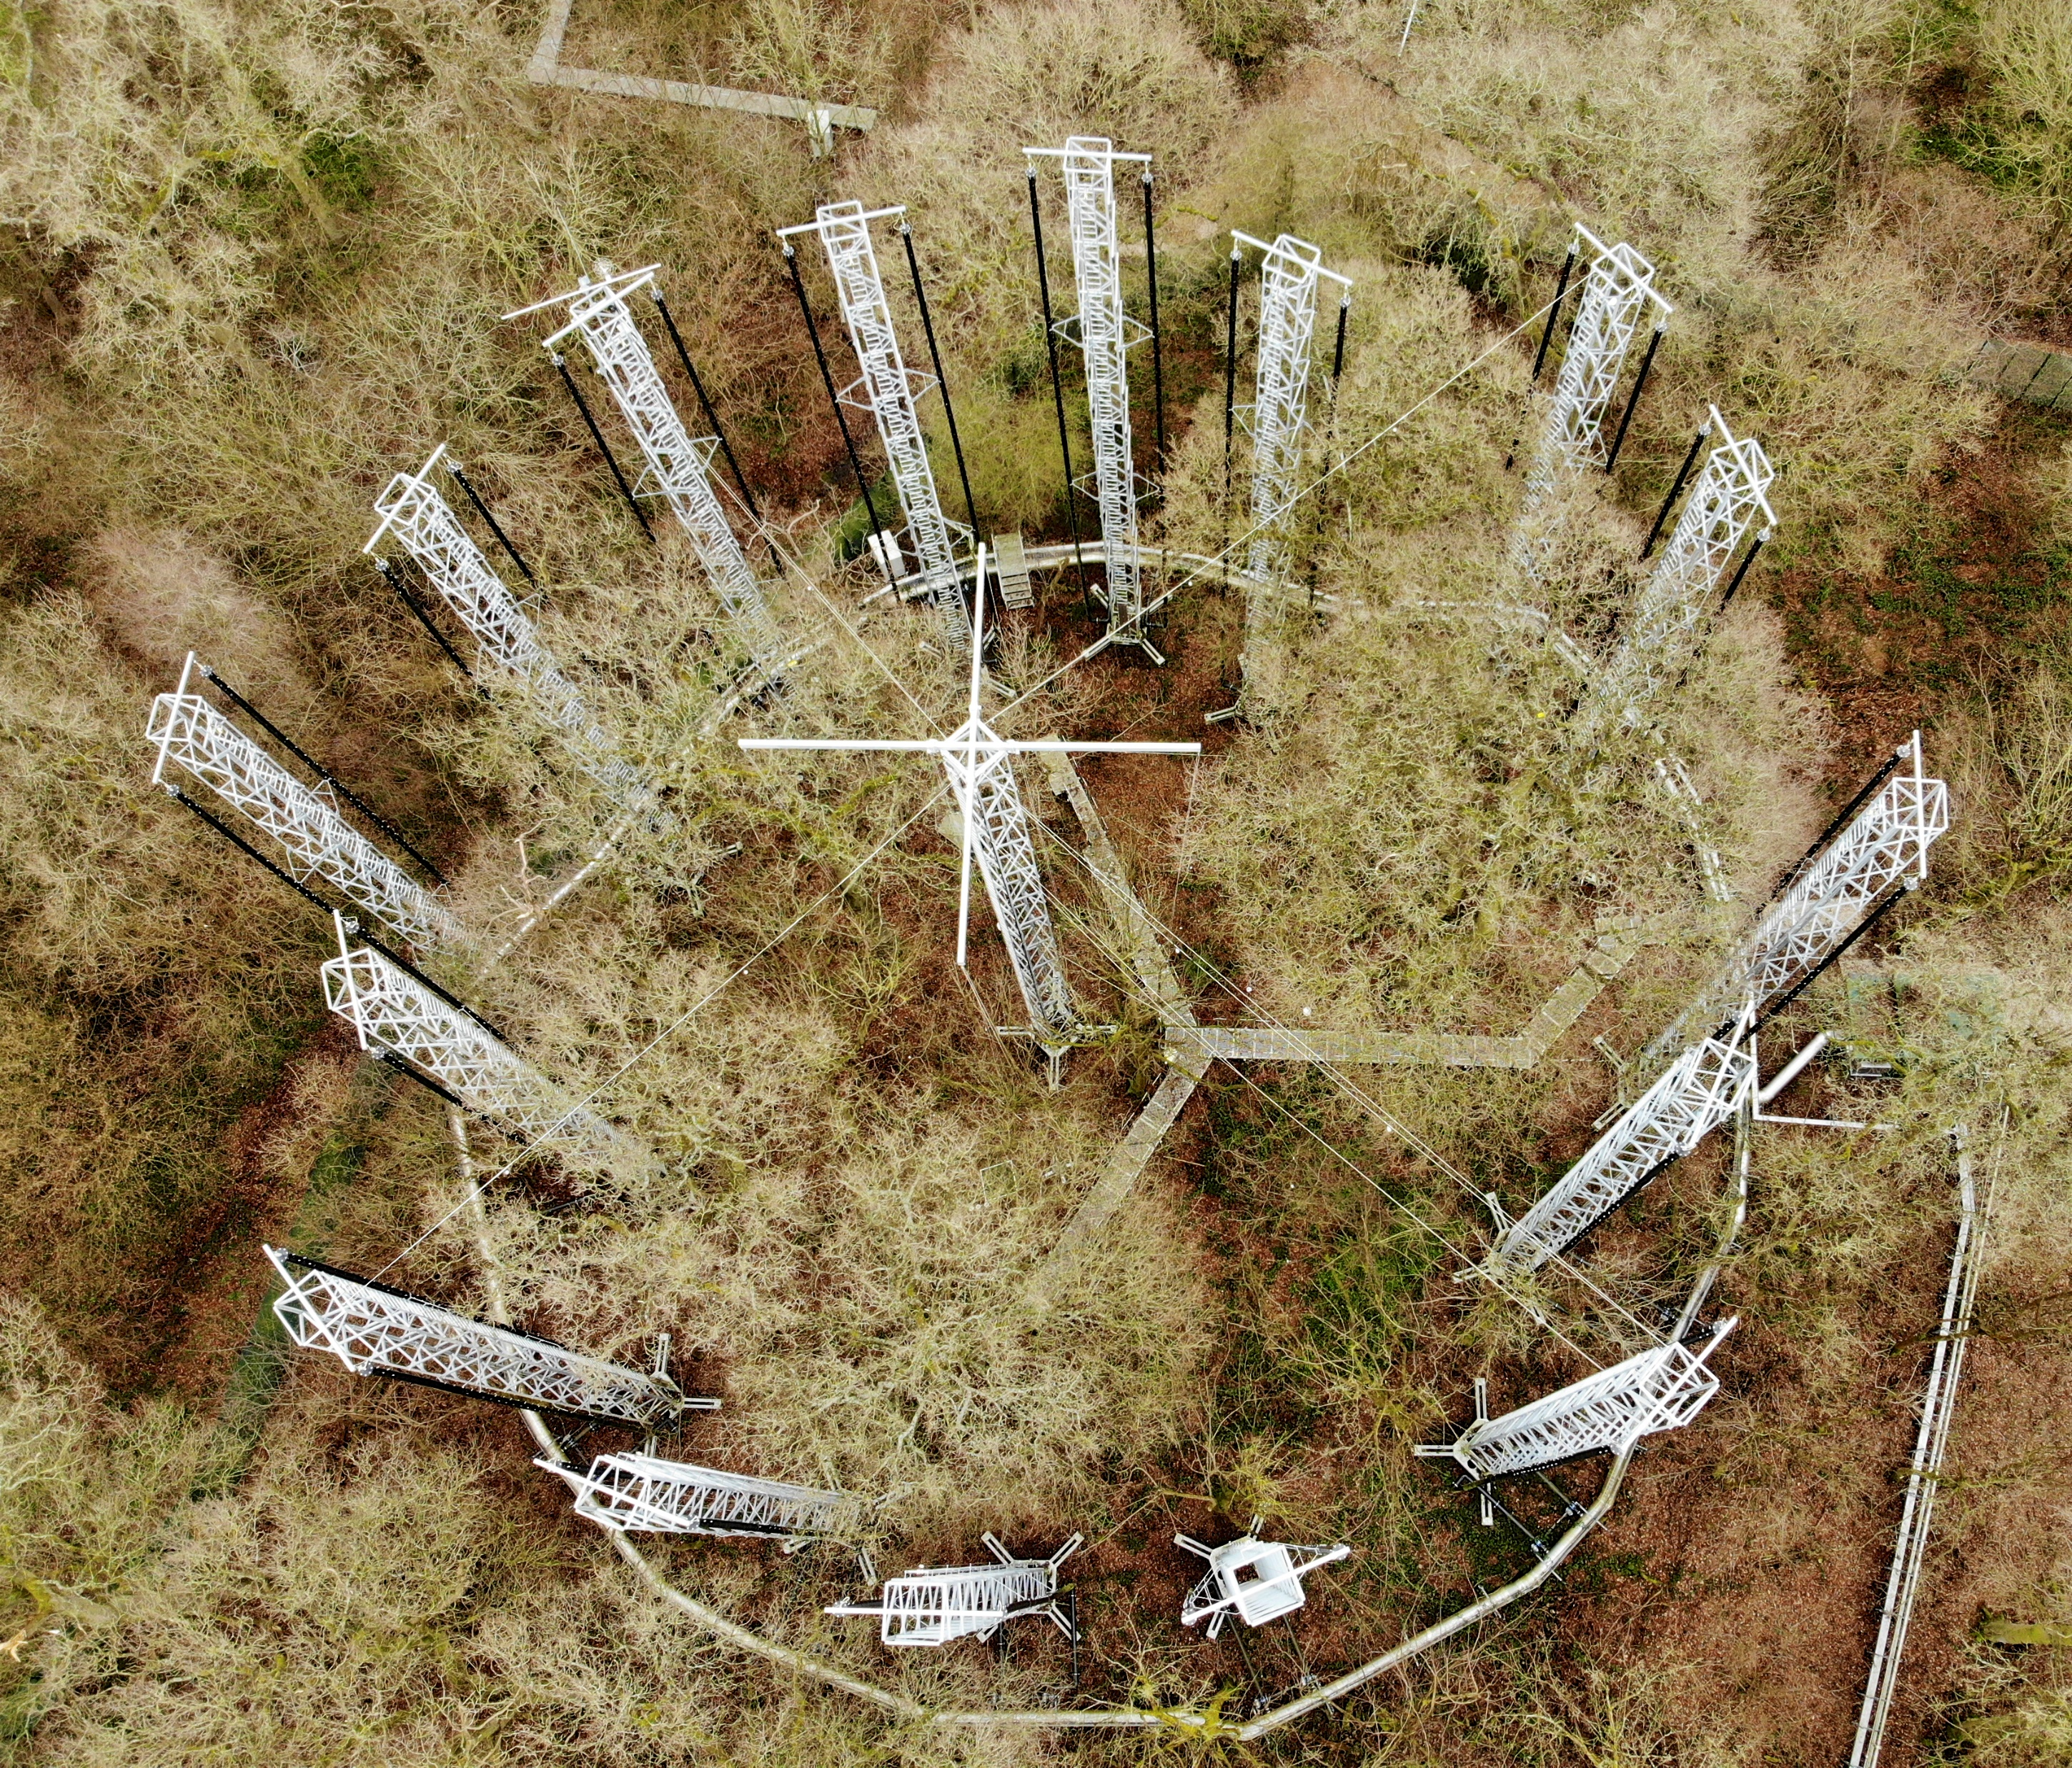
Can trees save the world?
Notes:
A carbon dioxide array in winter. Credit Birmingham Institute of Forest Research (BIFoR).
When the trees are bare in winter the structure of the research arrays that control the carbon dioxide levels around individual trees can be seen more clearly

Slide 17
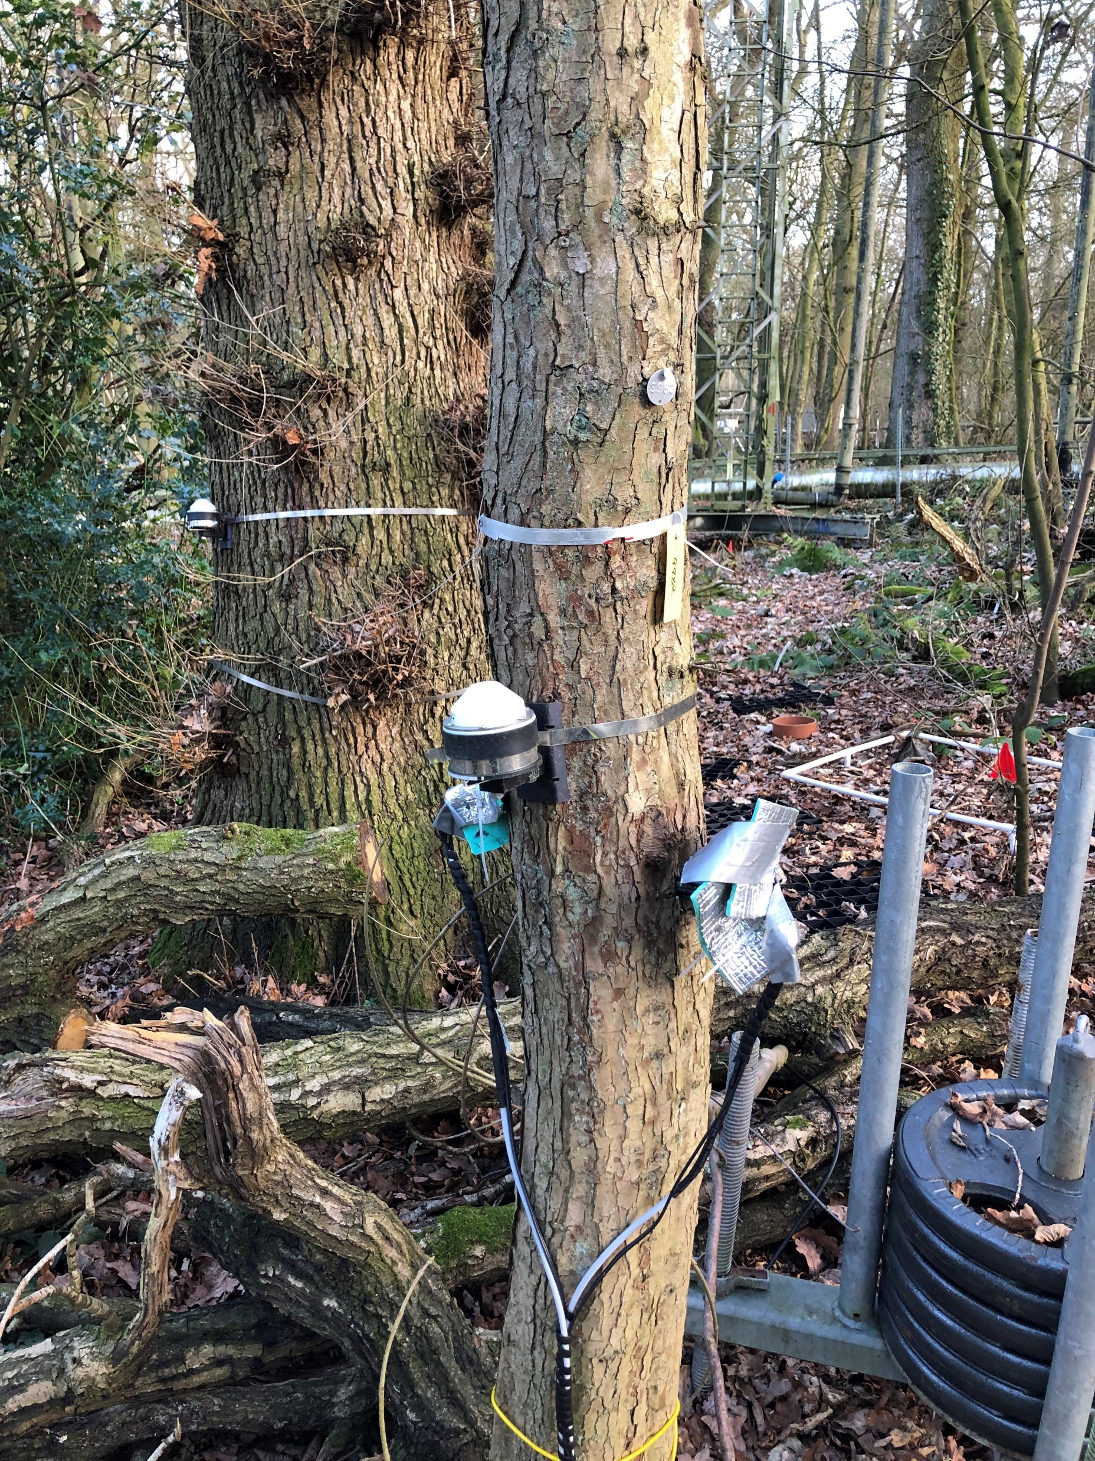
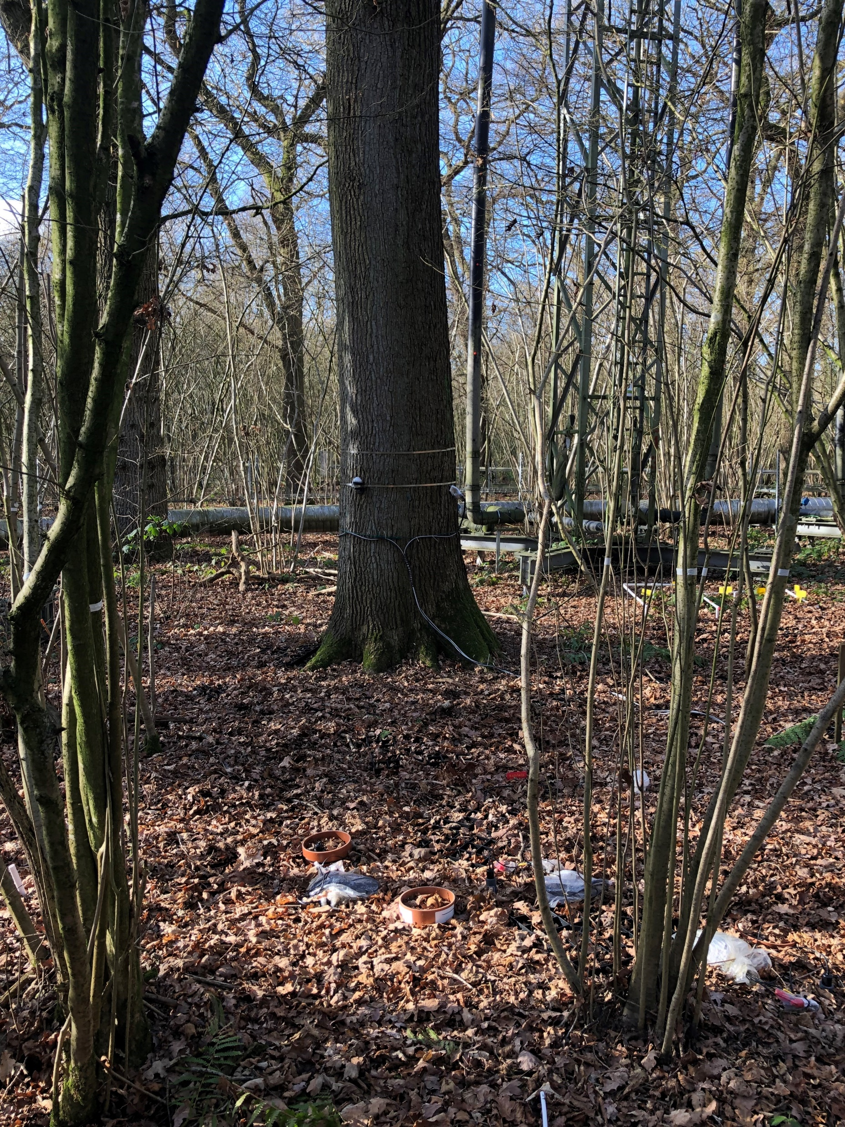
Can trees save the world?
Dendrometers around different trees
Notes:
Birmingham Institute of Forest Research (BIFoR).
One key measure scientists are looking at is the effect of different atmospheric carbon dioxide levels on the circumference of trees. They measure this using apparatus called dendrometers – basically extendable metal bands around the trees. On the BIFoR website, there are instructions for students to make their own dendrometer and take part in some citizen science see https://canvas.bham.ac.uk/courses/52405/pages/bifor-in-a-box.

Slide 18
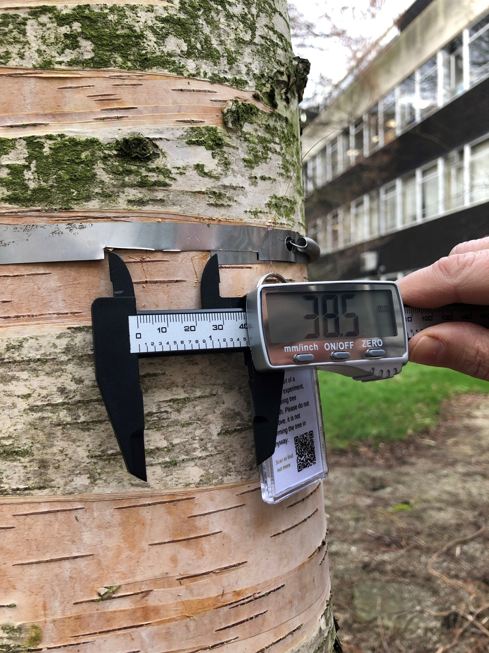
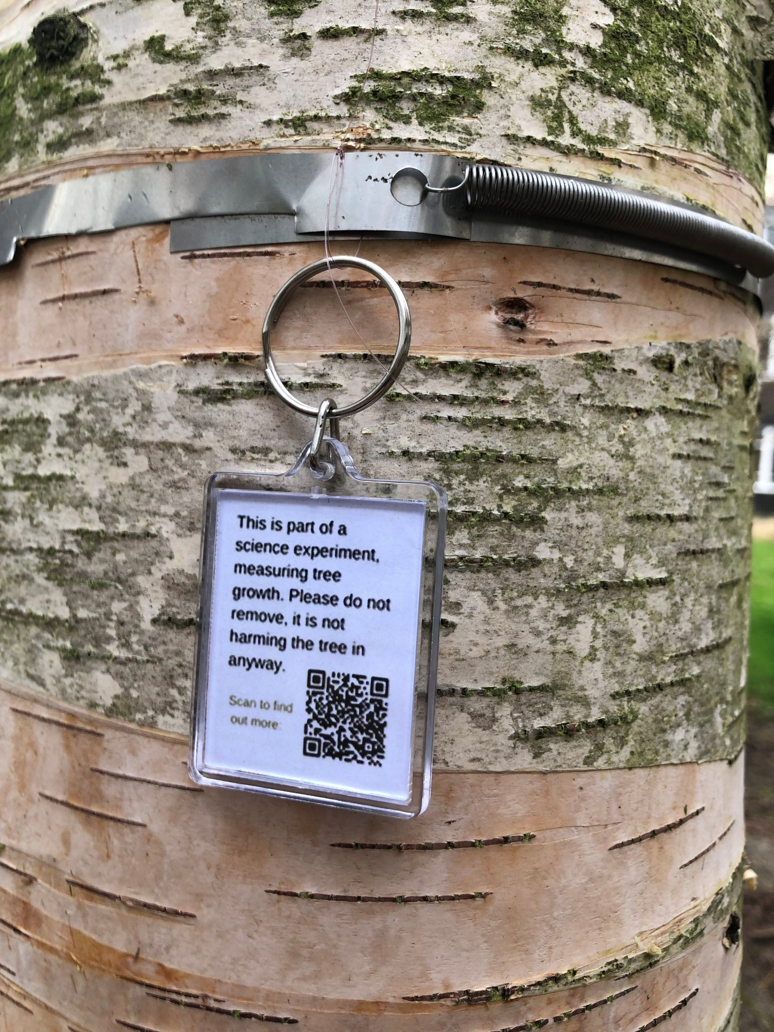
Can trees save the world?
Notes:
Birmingham Institute of Forest Research (BIFoR).
https://canvas.bham.ac.uk/courses/52405/pages/dendrometer-activity. One way of assessing the impact of varying carbon dioxide levels in the atmosphere is to measure the diameter of trees exposed to different carbon dioxide levels and see how much they expand. Other investigations include looking at the levels of fungal attacks on the leaves of trees. Students predict the impacts they would expect with explanations of how these impacts might come about.

Slide 19
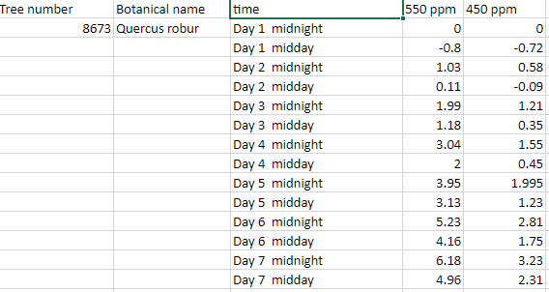
Can trees save the world?
Notes:
Birmingham Institute of Forest Research (BIFoR).
Data from an oak tree exposed to different levels of carbon dioxide in the surrounding air – 550 parts per million compared to 450 parts per million. Students could use this data (or other data sets from the BIFoR site and resources) to represent graphically the impact of different carbon dioxide levels on the girth/circumference of an oak tree OR These data are displayed graphically on the next slide for students to discuss.

Slide 20
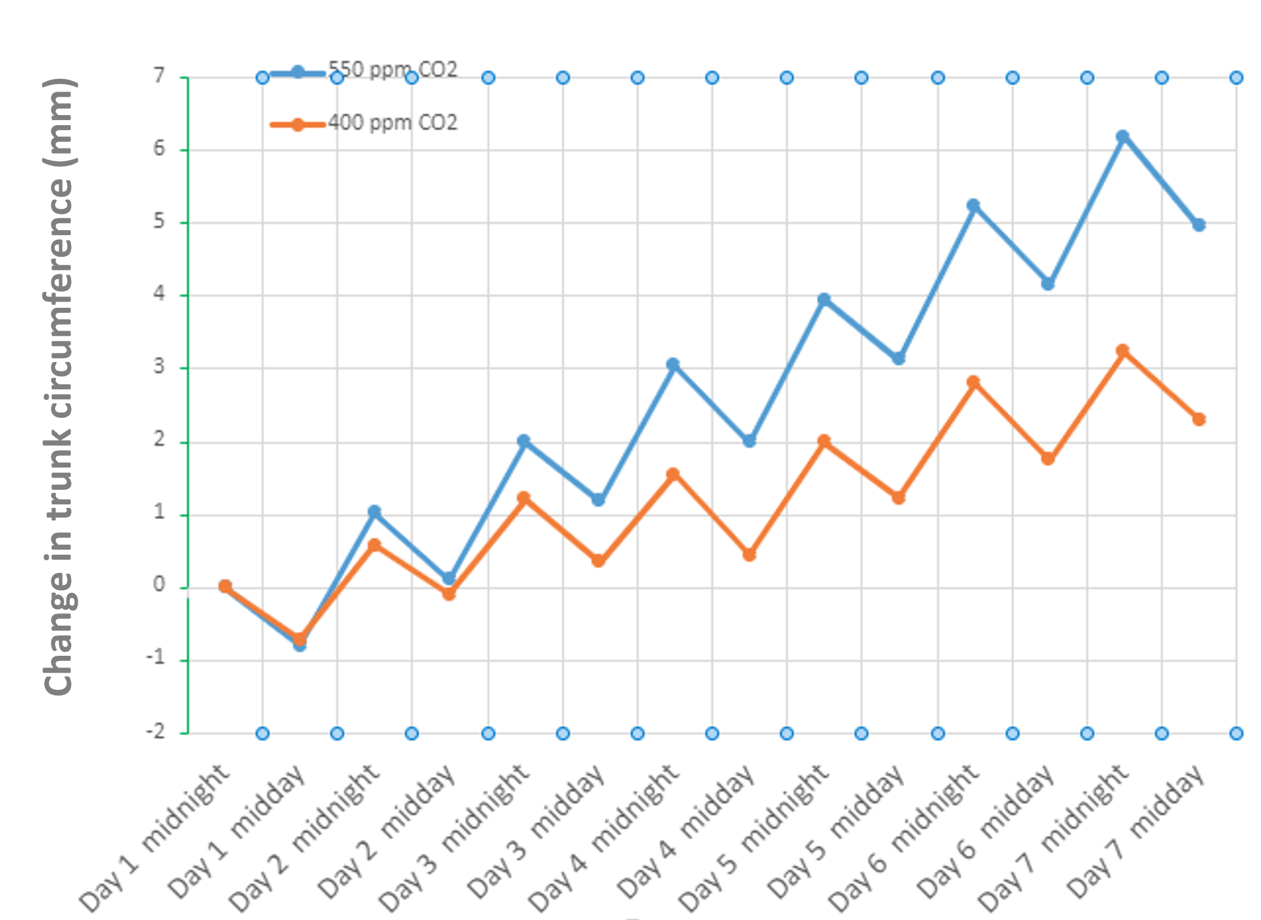
Can trees save the world?
Notes:
Birmingham Institute of Forest Research (BIFoR).
Graphical representation of the data from the previous slide shows the impact of higher carbon dioxide concentrations on the circumference of the tree trunk. Discuss with students possible reasons for these observed facts and also what this might mean for trees helping mitigate the impact of raising atmospheric carbon dioxide levels.

